Slide 1
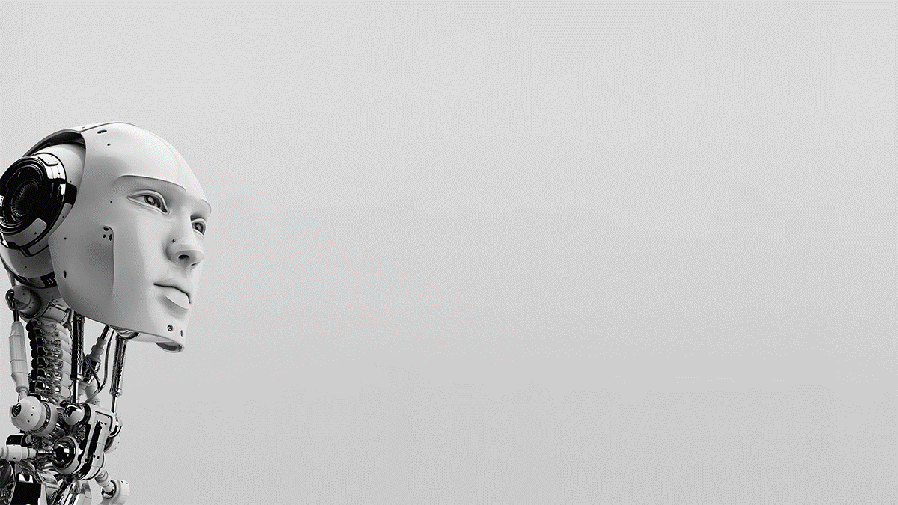
Linear Algebra in Machine Learning
Arun SR

Slide 2
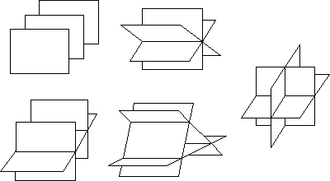
What is Linear Algebra
Branch of mathematics that described coordinates and interactions of planes in higher dimensions and perform operations on them.
data as linear equations represented in the form of vectors and matrices.

Slide 3
Why Linear Algebra in ML ?
Notation
Read & understands Algorithms, Research Papers etc
Operations
Learn how to do operations like addition, scalar multiplication, inverting, transpose etc
Factorization (!)
Diagonalization, SVD, PCA

Slide 4
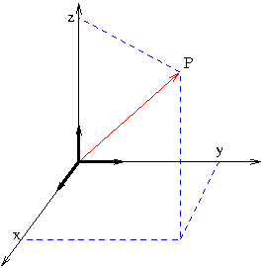
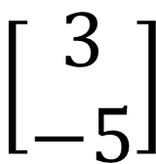

Vectors
Physicist
Engineers
Mathematicians
$$\left[\begin{matrix}3 \\ −5\end{matrix}\right]$$
$$\vec{v}+2\vec{w}$$
Notes:
Vectors to matrix
Wind + Propeller = direction of airplane
Equation as vectors
Solutions of simple equations

Slide 5
Matrix & Operations
Addition
Matrix Multiplication
Scalar Multiplication
Transpose
Determinant
Inverse (AA⁻¹ = I)
Solutions of Equations
Least square solutions / Pseudo Solutions / Optimal Solutions
Notes:
Solutions of equations Ax = B
x+2y = 4;
2x+y = 5
Augment Matrix [AB]
Elementary transformation -> Rank of a matrix
A^{T} Ax = A^{T} b
|| b - A x’ || <= || b - A x ||

Slide 6
Eigen Values and Eigen Vectors
Non-zero vector that changes by only a scalar factor when that linear transformation is applied
Finite dimension & Square Matrix
Properties
Trace, Dimension
Notes:
[2 , 1
1, 2 ]
Eigen Values = 3, -1 , (1,1) (-1,1) are eigen vectors
Characteristic equation

Slide 7
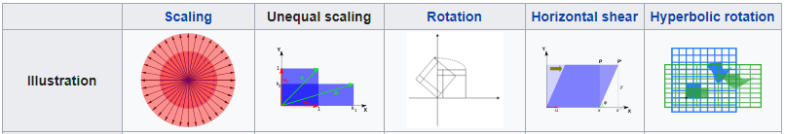
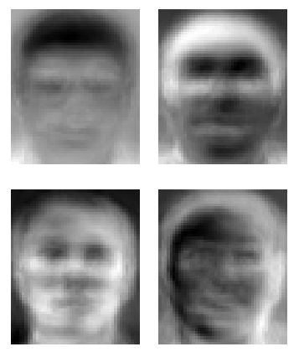
Why Eigen ?
Eigenfaces

Slide 8
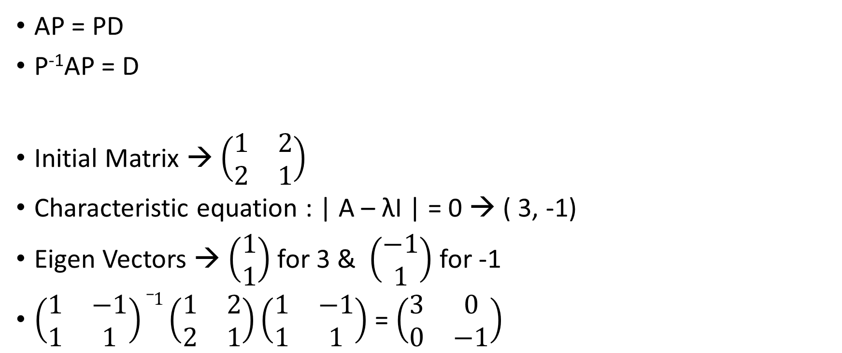
Diagonalization
AP = PD
P⁻¹AP = D
Initial Matrix → $\left(\begin{matrix}1 & 2 \\ 2 & 1\end{matrix}\right)$
Characteristic equation : | A – λI | = 0 → ( 3, -1)
Eigen Vectors → $\left(\begin{aligned}1 \\ 1\end{aligned}\right)$ for 3 & $\left(\begin{aligned}−1 \\ 1\end{aligned}\right)$ for -1
$\left(\begin{matrix}1 & −1 \\ 1 & 1\end{matrix}\right)_1\left(\begin{matrix}1 & 2 \\ 2 & 1\end{matrix}\right)\left(\begin{matrix}1 & −1 \\ 1 & 1\end{matrix}\right)$ = $\left(\begin{matrix}3 & 0 \\ 0 & −1\end{matrix}\right)$
Notes:
Application: Find A^1000 = P D^1000 P-1
Non Square Matrix – for next slide

Slide 9


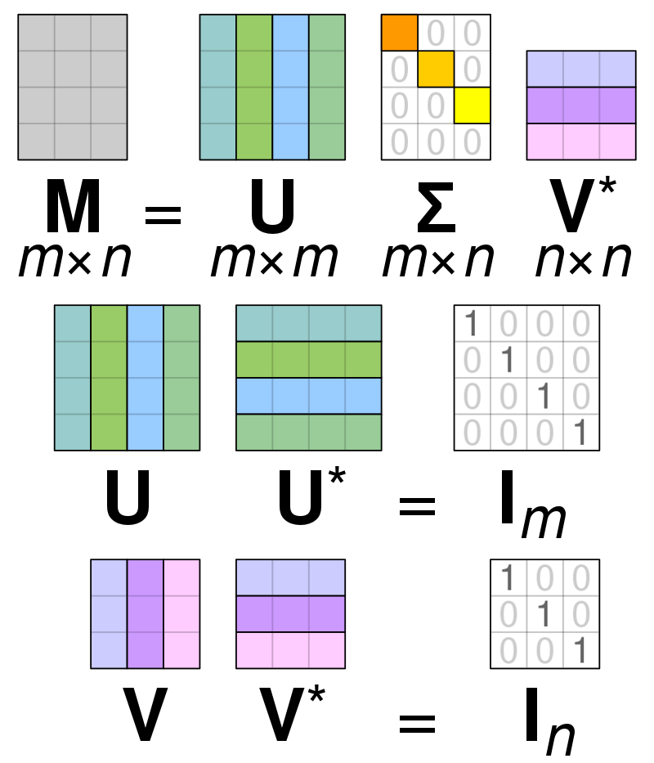
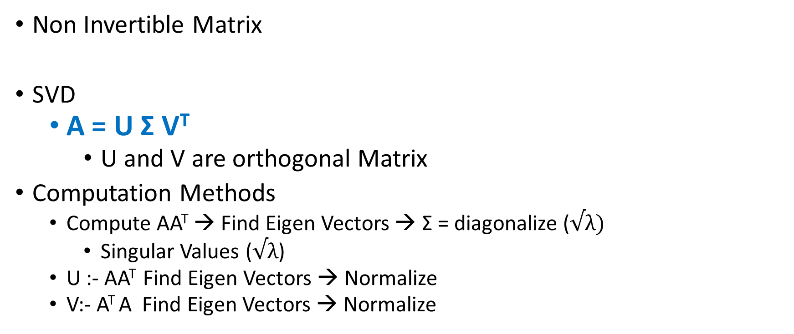
Single Value Decomposition
Non Invertible Matrix
SVD
A = U Σ V^{T}
U and V are orthogonal Matrix
Computation Methods
Compute AA^{T} → Find Eigen Vectors → Σ = diagonalize ($√λ)$
Singular Values ($√λ$)
U :- AA^{T} Find Eigen Vectors → Normalize
V:- A^{T} A Find Eigen Vectors → Normalize

Slide 10

Coding
from numpy import diag
from scipy.linalg import svd
# Singular-value decomposition
U, s, VT = svd(A)
# create n x n Sigma matrix
Sigma = diag(s)

Slide 11
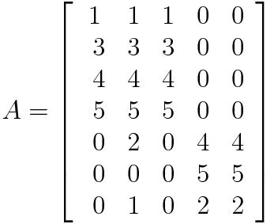
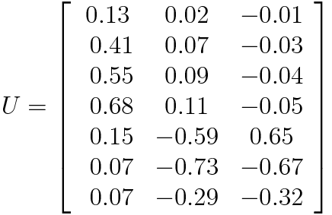
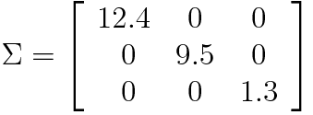
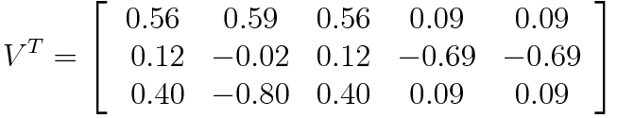
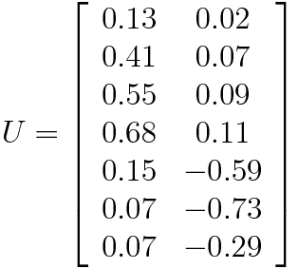


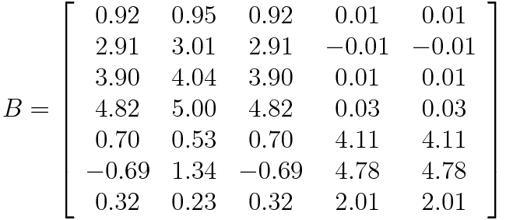
Application
C1 C2 C3- Sci-Fi movies & C4 C5 Romance movies).
Notes:
U = first user science fiction compared to romance (0.13 vs 0.02 etc.
E = weight of sci fic , romance
V = Degree to which a movie belongs to a category
3rd dimension not considered. In matrix 𝚺, the third diagonal entry which represents the weight of a movie category has a small value(1.3 score). Two categories of movies. So most of the third dimension is considered as noise

